Slide 1

KHATRA ADIBASI MAHAVIDYALAYA
E-CONTENT
DEPARTMENT OF EDUCATION
SEMESTER-I (PROGRAMME)
SESSION: 2020-2021
SUBJECT: EDUCATION
COURSE TITLE: PRINCIPLES AND PRACTICES OF EDUCATION
COURSE CODE: AP/EDN/101/C-1A
TOPIC: CHILD CENTRIC EDUCATION
NAME OF THE TEACHER: AKINCHAN PAL
Notes:
, ,

Slide 2
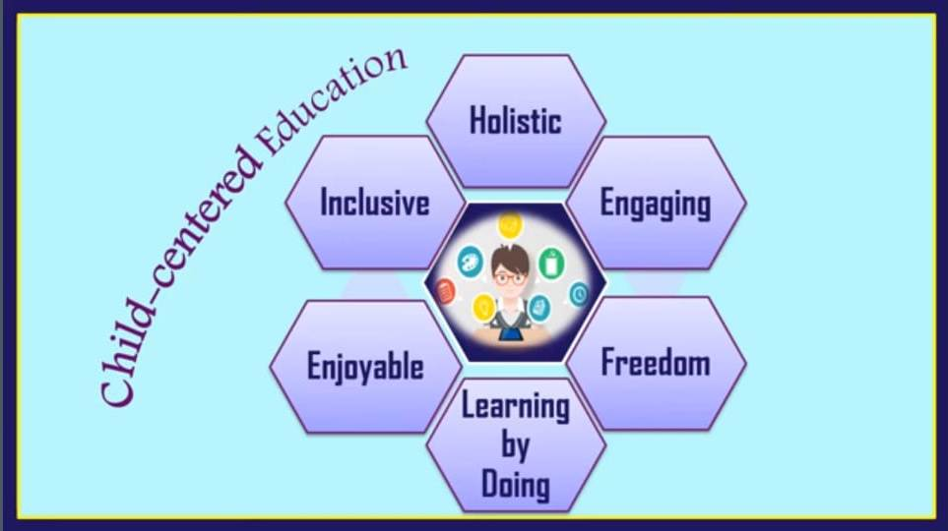

Slide 3
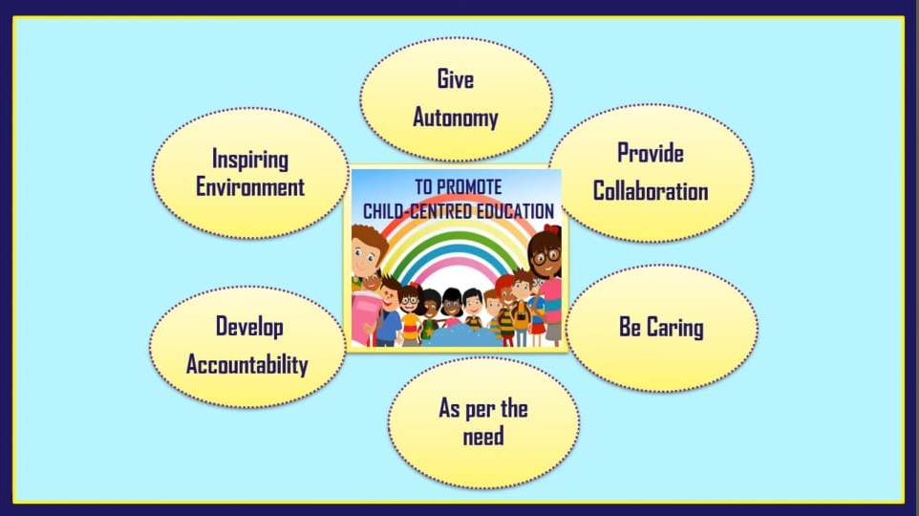

Slide 4
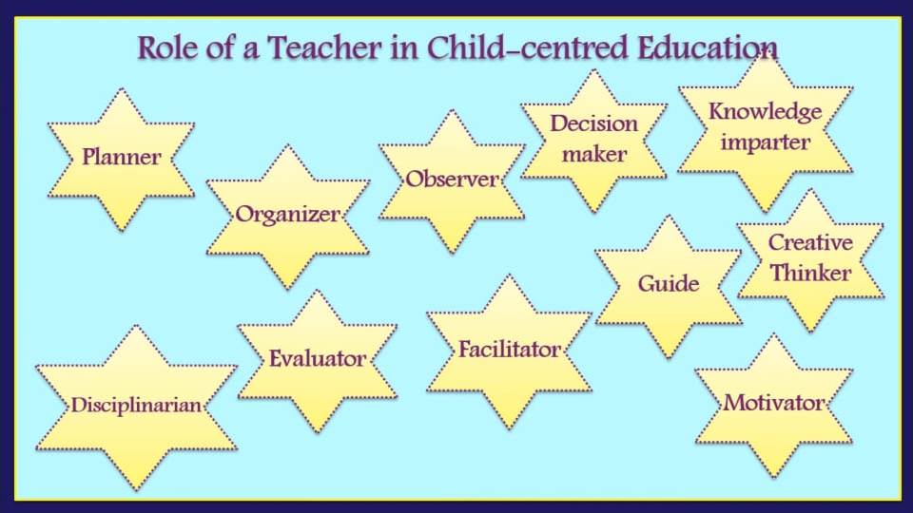

Slide 5
